Slide 1


E D U C A T I O N A L P S Y C H O L O G Y S E R V I C E
Understanding Attachment in the classroom
January 2015
Scott I-Patrick
Trainee Educational Psychologist

Slide 2

E D U C A T I O N A L P S Y C H O L O G Y S E R V I C E
Aims
To understand the basic concept of attachment and its relevance to learning
To recognise the behaviour patterns that may result from developing different types of attachment style
To understand some of the ways in which teachers can support the learning of insecurely attached children and young people

Slide 3
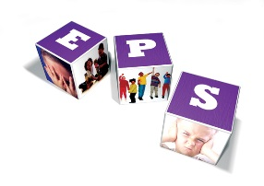
Innate need for Survival
E D U C A T I O N A L P S Y C H O L O G Y S E R V I C E
5 fulfilment needs
Higher level needs
4 esteem needs
3 social needs
2 safety needs
Basic needs
1 physiological needs
Maslow’s hierarchy of needs

Slide 4
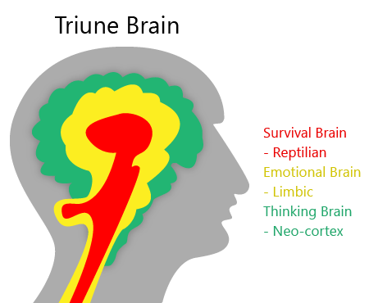
E D U C A T I O N A L P S Y C H O L O G Y S E R V I C E
Reptilian brain is about avoiding harm and seeking resource for sustenance
Mammalian brain is centre for emotion
Neo-cortex for thinking
(Paul MacLean)
Notes:
2 parts; seeking and approaching – avoiding

Slide 5
E D U C A T I O N A L P S Y C H O L O G Y S E R V I C E
What is attachment?
The bond between a caregiver and a child
The relationship a child makes with an adult in response to caregiving
A living breathing pattern that affects us all throughout the lifespan and determines how safe we feel.
Woven in to the pathways of our brain in the earliest phase of life.

Slide 6

E D U C A T I O N A L P S Y C H O L O G Y S E R V I C E

Slide 7
E D U C A T I O N A L P S Y C H O L O G Y S E R V I C E
Organising experiences
Attachment theory outlines how the internal life of a child is organised around the early experiences of caregiving received.
There are various dimensions to caregiving

Slide 8
E D U C A T I O N A L P S Y C H O L O G Y S E R V I C E
Dimensions to caregiving
Positive | Negative
Sensitivity - mother recognises baby’s needs and responds appropriately to his signals | Insensitivity -mother fails to reads baby’s signals and interacts according to her own needs and wants
Acceptance – mother accepts her responsibilities, responds to baby’s needs, and acknowledges that parenthood involves constraints on her lifestyle and behaviour. She accepts her baby regardless of his mood. | Rejection – mother resents the emotional demands made on her by baby, and rejects the baby. She may feel guilty about this and become irritable with baby’s refusal to be satisfied and responsive to her.
Cooperation – mother recognises, supports and respects her baby’s autonomy and appears to ‘co-operate’ with his needs and accomplishments. | Interference – mother does not recognise or respect baby’s independence and seeks to define his experience. Mother is often abrupt, impatient and aggressive.
Accessibility – mother is physically and emotionally available and accessible to baby | Ignoring – mother is either physically or emotionally unavailable and with-holding

Slide 9
E D U C A T I O N A L P S Y C H O L O G Y S E R V I C E
Manifestation of attachment?
Two dimensions:
Internal constellation – working model
External manifestation - Behaviour
Behaviour is driven by the internal working model

Slide 10
E D U C A T I O N A L P S Y C H O L O G Y S E R V I C E
Internal working model
A child’s experience of caregiving helps create;
A working model to help the child survive
A map of the self and of the world which is needed in order to be able to predict, control and manipulate the environment.’
An internal model that consists of the child’s concept of self, others, the world and relationships

Slide 11
E D U C A T I O N A L P S Y C H O L O G Y S E R V I C E
Internal working model
Internal Working Model (organised mental representations of the self and others)
Positive | Negative
Self I am worthwhile I am safe I am capable | Self I am worthless I am unsafe I am impotent
Carers/others They are available They are responsive They meet my needs | Carers/others They are unresponsive They are unreliable They are threatening They are dangerous They are rejecting

Slide 12
E D U C A T I O N A L P S Y C H O L O G Y S E R V I C E
External Manifestation - Behaviour
The four patterns of attachment
Securely attached
Insecure/ ambivalent-resistant
Insecure/ avoidant
Insecure/ disorganised

Slide 13
E D U C A T I O N A L P S Y C H O L O G Y S E R V I C E

Slide 14
E D U C A T I O N A L P S Y C H O L O G Y S E R V I C E
Task
How might these four different external manifestations / patterns of attachment affect a child’s ability to learn?
Securely attached
Insecure/ ambivalent-resistant
Insecure/ avoidant
Insecure/ disorganised
(20 Minutes)

Slide 15
E D U C A T I O N A L P S Y C H O L O G Y S E R V I C E
Attachment and learning
PUPIL
The Learning Triangle
TEACHER
TASK
(Geddes 2006, p.4)
Notes:
In any learning experience, there is a triangle between teacher, pupil and task. Child must feel secure and trust the relationship with the teacher in order for them to learn.

Slide 16
E D U C A T I O N A L P S Y C H O L O G Y S E R V I C E
Summary
Attachment is…
A living breathing pattern that affects us all throughout the lifespan and determines how safe we feel.
Woven in to the pathways of our brain in the earliest phase of life and determines to a great degree our capacity for learning
A response to the caregiving received as a baby and a means of survival in that early ‘holding environment
Represented in our thoughts, feelings and wishes by an internal working model which shapes our behaviour.
How we learn to think, understand and make sense of the world. It determines our attitude towards exploring the unknown.
The organising principle for a set of thoughts, feelings and beliefs and a system of behaviours which can be activated by particular triggers at any point in time.
Secure for 55-65% of the population and insecure for the rest, be it either avoidant, ambivalent, or disorganised

Slide 17
E D U C A T I O N A L P S Y C H O L O G Y S E R V I C E
If a duck walks like a duck, talks like a duck, behaves like a duck…..
…..it must be a duck
Our knowledge & experience of ducks tell us what to expect from the duck and how to relate to it

Slide 18
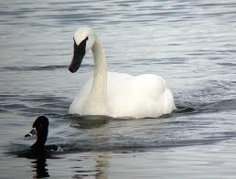
But what if the duck thinks it’s a swan?
E D U C A T I O N A L P S Y C H O L O G Y S E R V I C E
It’s not what children do, but why they do it that is crucial to being able to relate effectively and intervene successfully.

Slide 19

E D U C A T I O N A L P S Y C H O L O G Y S E R V I C E
References
Barna,G. (2007) Revolutionary Parenting: What Research Shows Really Works. Ventura, C.A:Barna Group
Cameron,R.J & Maginn,C (2009) Achieving Positive Outcomes for Children in Care. Sage Publications
Child Cruelty in the UK 2011. www. nspcc.org.uk
Child Welfare Information Gateway
DCSF: Children Looked After in England
Geddes, H. (2006) Attachment in the Classroom. Worth Publishing
Golding,K et al (2008) Thinking Psychologically About Children who are Looked After and Adopted. Wiley
Hughes,D. (2006) Building the Bonds of Attachment. Jason Aronson
Pearce, C. (2009) Attachment & Attachment Disorder. Jessica Kingsley Publishers
Perry, A. (2009) Teenagers and Attachment. Worth Publishing

Slide 20
E D U C A T I O N A L P S Y C H O L O G Y S E R V I C E
Thank you

